Slide 1
FLS Unit 6
Stats
Johnny Vogt

Slide 2
Quick Questions
A, we need at least the variance to be able to start determining if any averages could possibly be equal to each other.
C, I think so.

Slide 3
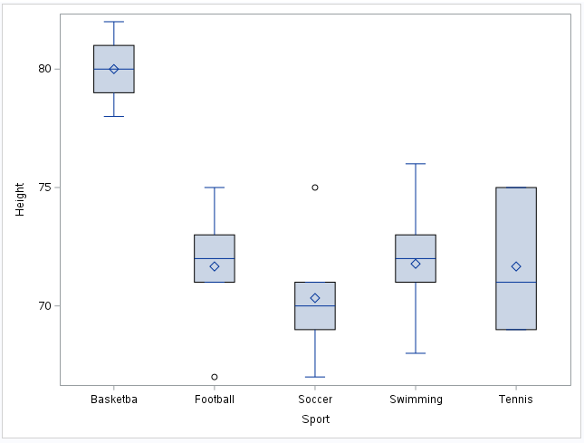
Heights in Different Sport - Box Plot

Slide 4
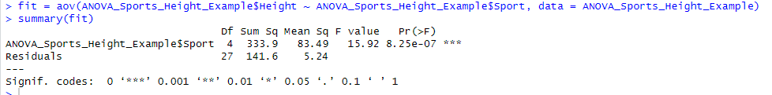
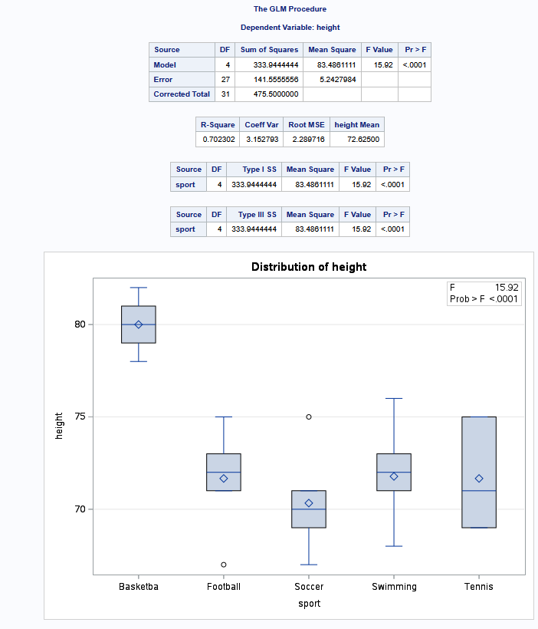
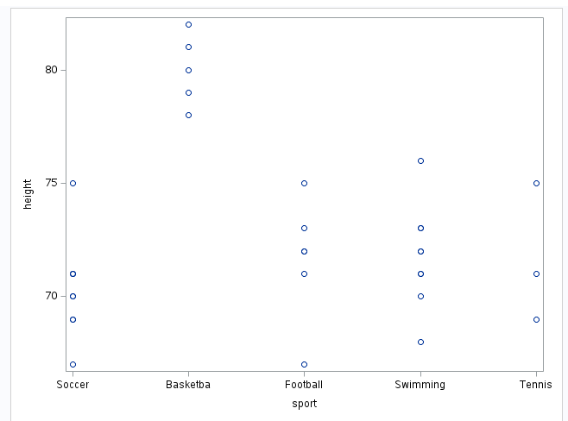
Sport Height - ANOVA SAS
Most group roughly have a bell shaped distribution, displaying some normality.
Each group’s QQ Plot follows pretty closely to the line. Which shows the data trending towards normality
Althought the Group for Tennis has a very low sample size compare to the others.
Its very likely that each group were independent of each other, but we are not given that data.

Slide 5
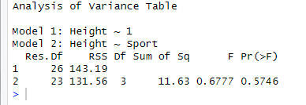
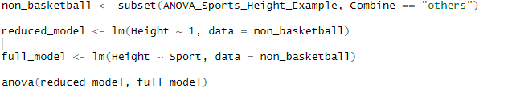
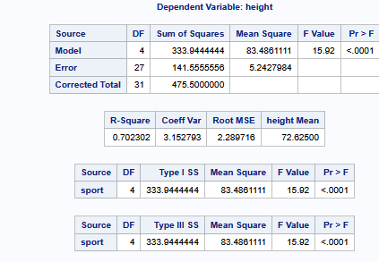
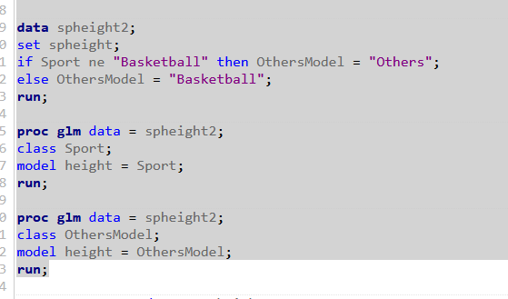
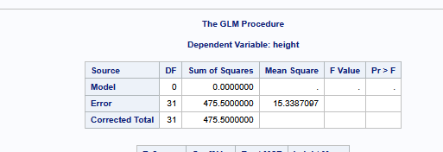
ANOVA Test WITHOUT BBALL
Creating two model, A reduced model and a full model. In the reduced model, we are testing if any of the means are different than the basketball mean and the Full model test if any of the other sports are different from each other.

Slide 6
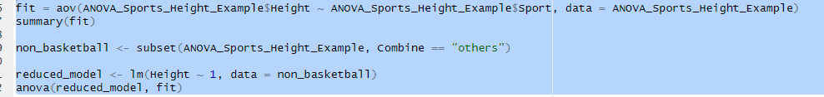
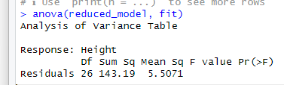
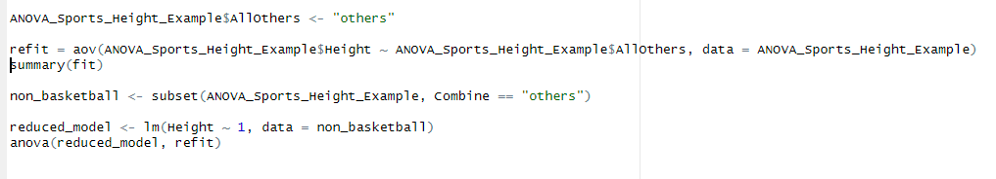
ANOVA comparing models with one where basketball is different from everyone and another where everything is the same
I kept getting errors here, but I had realized that I used “fit” , but that model was comparing if ANY of the means were different, but I needed a model that would compare all the means were the same. I had looked up if I did it right, but it kept saying I was wrong, so I tried recreating “refit” which was me attempting to classify it all as “others” and making a model with that, but I kept getting errors.

Slide 7
Takeaways
I’m definitely lost here, I thought I got it, than I didnt get it, but than I thought i was right but wasn’t
Are these not fundamentally the same thing?
H_{a}: Full Model: µ_{B} µ_{F} µ_{Soc} µ_{Swim} µ_{T}
H_{o}: Reduced Model: µ_{O} µ_{O} µ_{O} µ_{O} µ_{O}
I know R^2 is very important, but I feel like the FLS didnt go over it much or maybe I was supposed to mention it in my conclusions.
This was VERY busy week for me, I wish I had time to sit and really absorb this content because this is probably the first week, where it seems that I’m not grasping it.
Im not sure why were using models like lm, or even what exactly aov does.

